Slide 1
Instagram User Analytics
Amudhan.A.R

Slide 2
Project Description
Goal: Analyze user activity, engagement, and identify trends on a social media platform, inspired by Instagram's structure.
Data Set: A simulated database with tables for users, photos, comments, likes, follows, tags, and photo-tags relationships.
Purpose: Provide insights for marketing, investor metrics, and platform improvements, such as identifying loyal users and detecting fake accounts.
Focus Areas: User behavior, post frequency, photo likes, most active users, hashtag popularity, and engagement trends.

Slide 3
Tech-Stack Used
MySQL workbench is the tool used to import data set and analyze results.

Slide 4
Approach
Copy/pasted the data set in MySQL and after executing queries, Tables are formed and ready to run.
Data Structure: Designed a relational database with multiple tables and relationships to simulate Instagram-like functionalities.
SQL Queries: Used SQL queries to extract, aggregate, and analyze key metrics such as photo likes, user activity, and popular hashtags.
Analytics Focus: Identified loyal users, inactive users, contest winners, and calculated engagement metrics using aggregate functions like COUNT and GROUP BY.
Reporting: Generated insights on user activity, photo engagement, and platform trends for marketing and investor needs

Slide 5
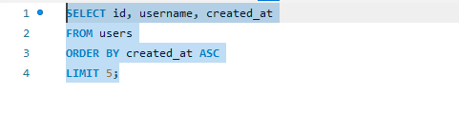
A) Marketing Analysis:
Loyal User Reward:

Slide 6
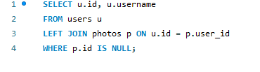
Inactive User Engagement

Slide 7
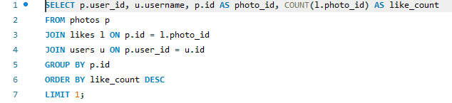
Contest Winner Declaration

Slide 8
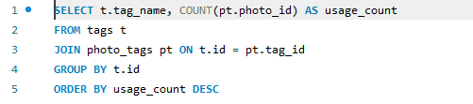
Hashtag Research

Slide 9
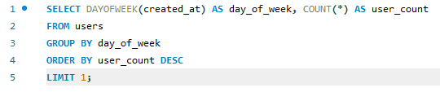
Ad Campaign Launch

Slide 10
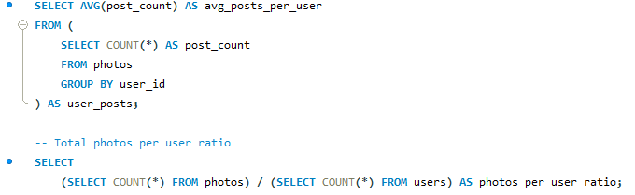
B) Investor Metrics:
User Engagement

Slide 11

Bots & Fake Accounts

Slide 12
Insights
Loyal Users: Identified users who have been active the longest, enabling targeted marketing efforts for retention.
Inactive Users: Found users who have never posted, suggesting opportunities for re-engagement campaigns.
Popular Hashtags: Discovered trending hashtags, allowing brands to reach a broader audience by aligning their posts with popular tags.
Engagement Trends: Revealed the average number of posts per user and the total photo-to-user ratio, providing a clear view of platform activity.

Slide 13
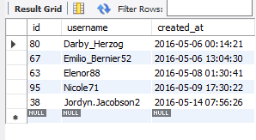
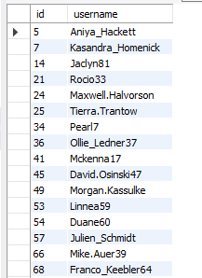
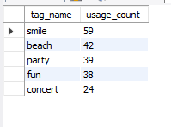


Marketing Analysis:

Slide 14

Investor Metrics:

